Slide 1
Analytic Tools and Decision Making
Dataset Name: Auto Insurance Claims Data
Team Introduction:
Group Number : 10
Section Number: 003
Team members:
Akash Sagar Sanda
Sai Kiran Jamalapur
Akhil Birru
Prathapreddy Pannala
Project Proposal

Slide 2
Background/Motivation – The Motivation behind was, vehicle insurance is mandatory, expensive and difficult to purchase for many consumers around the globe. There might be many people whose Insurance got rejected because of not knowing the any analysis and insights behind how the Insurance is approved . Many people as to lose their money due to less knowledge and awareness. As this dataset include data about “Auto insurance” and all the major factors that are used to decide whether the applicant will be granted Insurance or not. Problem Statement – Every applicant needs to know what all are the factors considered to approve Insurance, what are major variables for correlation to Insurance. We as a team will provide complete and accurate analysis and Insights. We will provide an easy and better way to understand all the key points of Insurance. So that every Individual will be having a complete picture how the Insurance is approved before applying. The analysis will be a key factor to other insurance organizations.
Background/
Motivation
Problem
Statement

Slide 3
Project Proposal: The key purpose of the project is to provide a complete descriptive analysis on
automobile insurance approval and crucial factors for fraud detection which will ultimately help every Individual who applies for vehicle insurance and at the same time which will be beneficial for insurance organization.
Analysis Questions:
1) How many number of frauds reported according to dataset?
2) How many number of insurance claimed by entire customers in particular period?
3) How many incident types have highest fraud cases that exceed non fraud cases?
4) Which age group has reported maximum frauds according to dataset?
5) Brief description about fraud reported by various auto models?
Dataset Description:
The analysis will be based on auto insurance claims dataset obtained from source: Auto Insurance Claims Data | Kaggle
Dataset consists of 40 columns and 1000 observations.
Dataset describes about fraud reported in three states Ohio , Illinois and Indiana in between year 1990 to 2015
EDA describing the dataset and preliminary visualization are available in below URL.
https://github.com/birruakhil58/DAB103

Slide 4
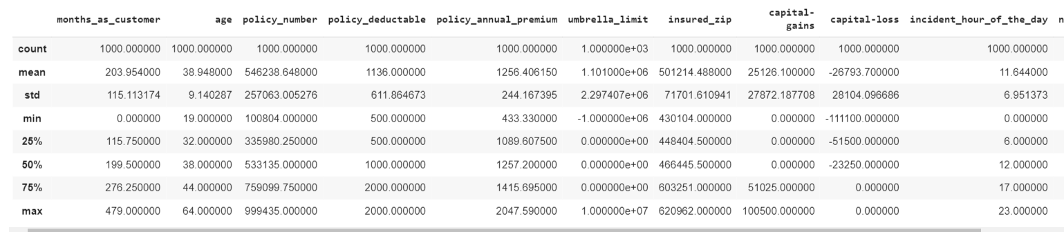
Development environment:
Jupiter notebook(Anaconda)
Python 3.8
Git hub
Excel
Exploratory Data Analysis (EDA) :
Dimensions of dataset:
Shape of dataset (1000,40)
Description about dataset:

Slide 5
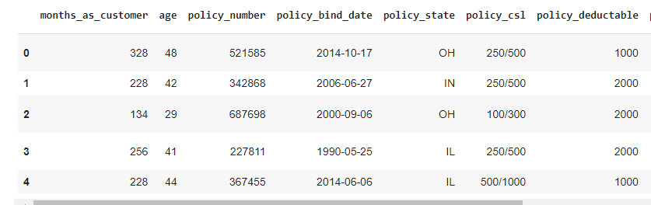
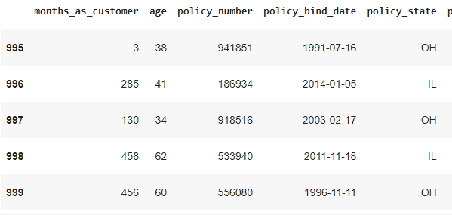
Dimensions of dataset:
Shape of dataset (1000,40)
Dataset head and tail
Sample of head
Sample of tail

Slide 6
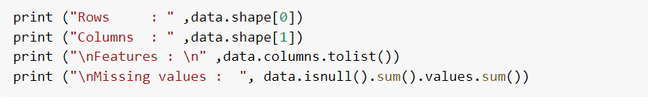
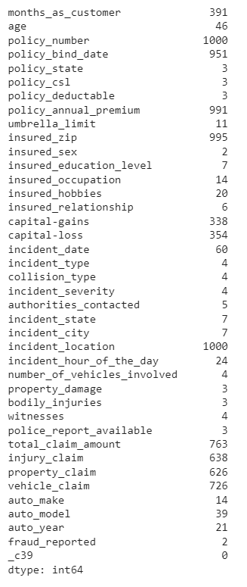
Information about dataset:
Unique values in dataset:

Slide 7
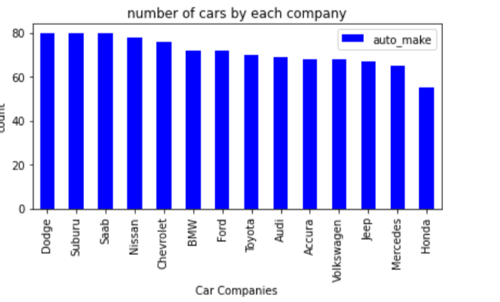
EDA Visualization:
Visualization about count of cars by each company:

Slide 8
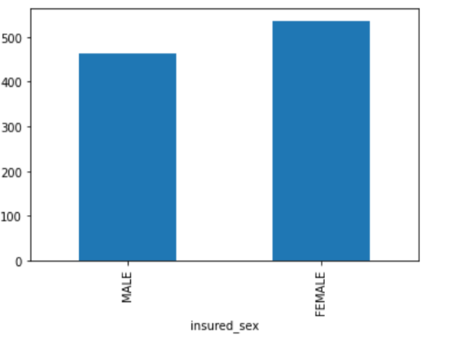
Count of fraud reported by gender:

Slide 9
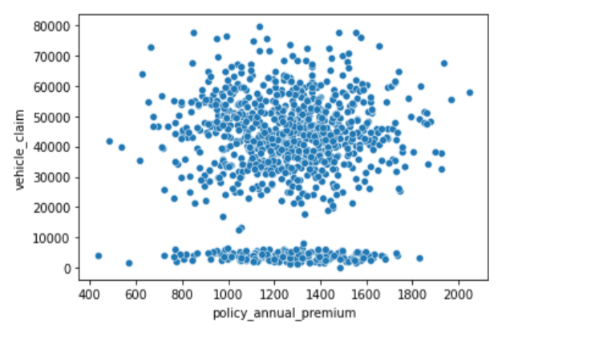
Plot between policy annual premium per month and vehicle claim:

Slide 10
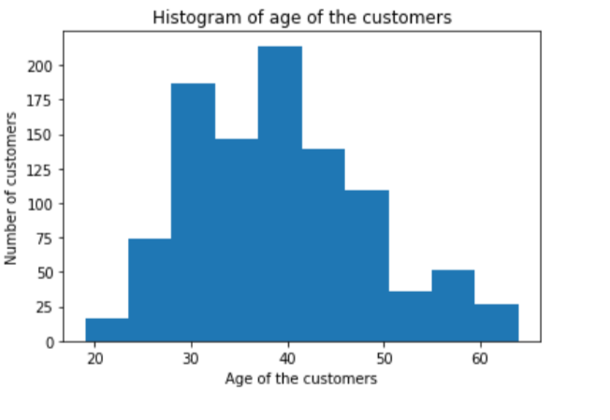
Plot between age of customers and their count using histogram:

Slide 11
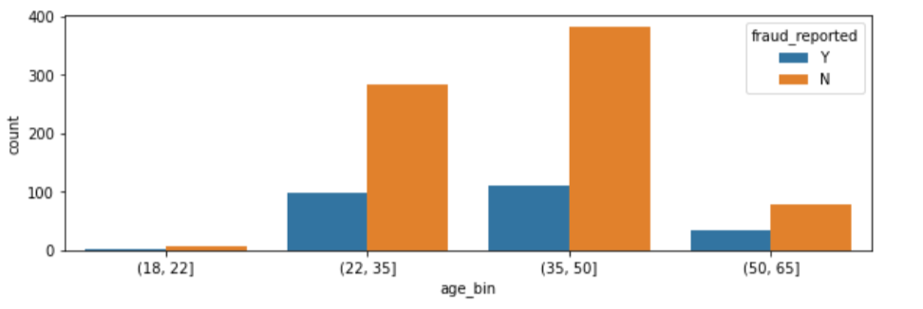
Count of insurance frauds reported by different age groups:

Slide 12
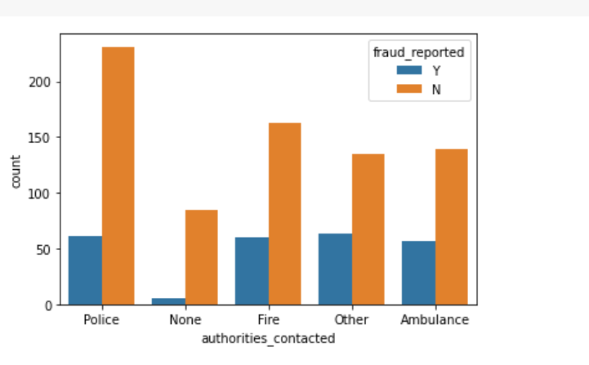
Plot between authorities contacted and count of fraud reported:

Slide 13
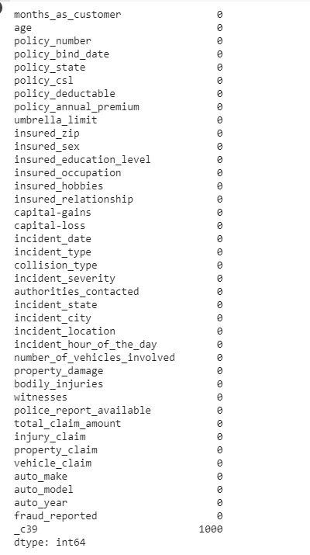
Data cleaning and Transformation :
Count of null values in the dataset:

Slide 14
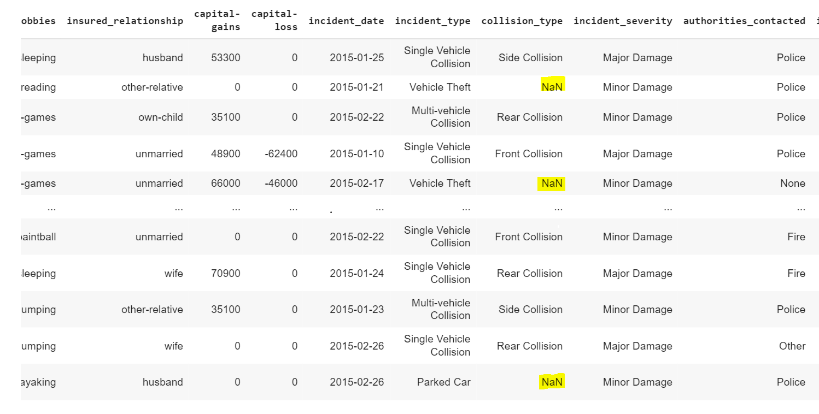
As we can see the dataset contains few null values. Using the drop function, we are removing
null values.
After performing drop() function there are zero null values in the dataset.
The above dataset also contains missing values. So , we are replacing it by using Nan values.
For reference find the below screenshot

Slide 15
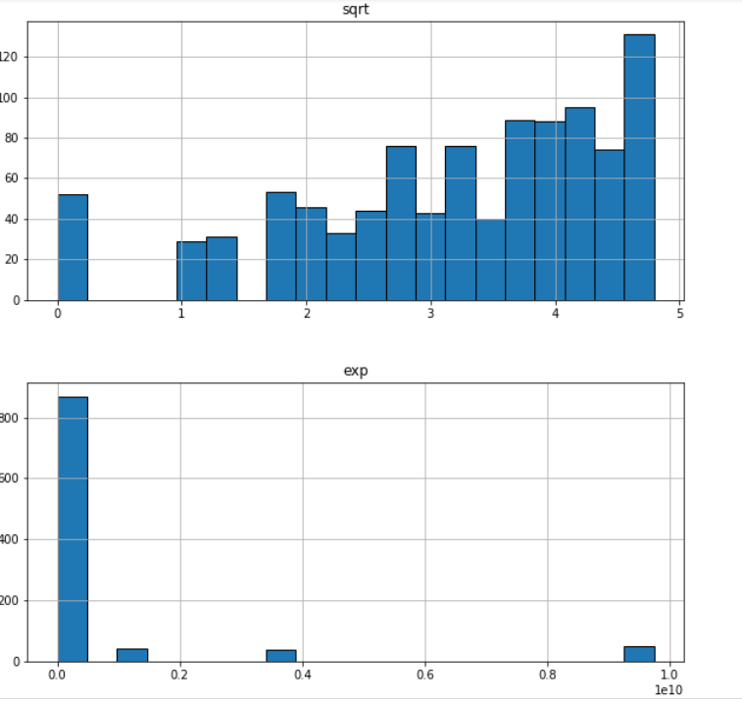
Data transformation:
We have applied data transformation on incident_hour_of_the_day using exponential and square root function.

Slide 16
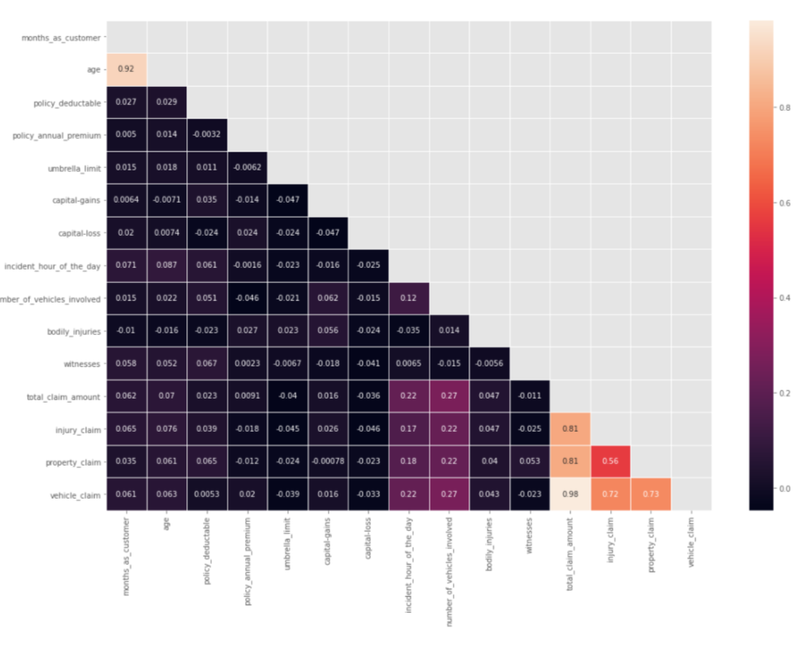
Data Analysis:
From the above plot, we can see that there is high correlation between age and months_as_customer. We will drop the "Age" column. Also there is high correlation between total_clam_amount, injury_claim, property_claim, vehicle_claim as total claim is the sum of all others. So,we will drop the total claim column.

Slide 17
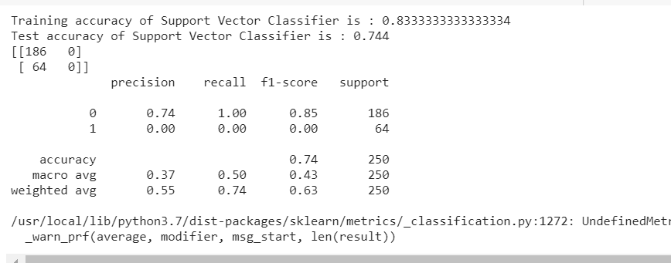
Model building:
We have built our models using below algorithms.
1)SVC
2)XgBoost classifier
3)Random forest classifier
SVC model:
PFA of screenshot for training accuracy and test accuracy of data using SVC model

Slide 18
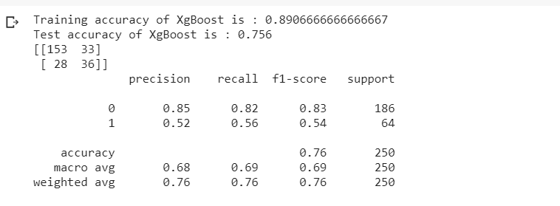
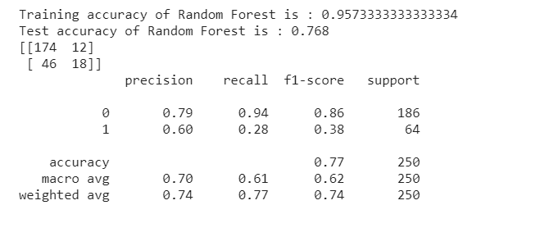
XgBoost classifier:
PFA of screenshot for training accuracy and test accuracy of data using XgBoostmodel.
Random Forest:
PFA of screenshot for training accuracy and test accuracy of data using Randomforest classifier.

Slide 19
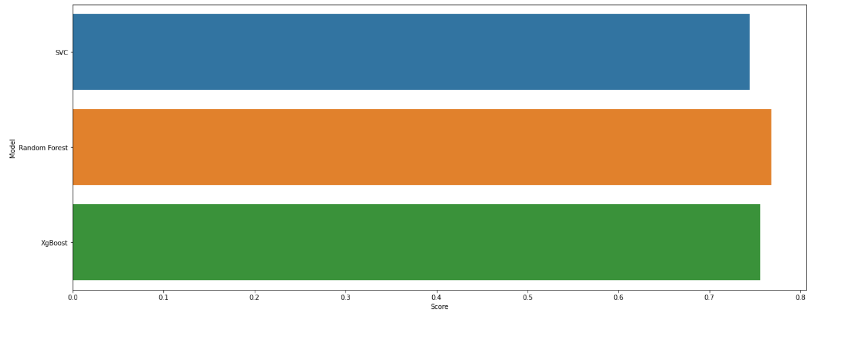
Plot between model and their accuracy score:
In this analysis, many factors were identified which allows for an accurate distinction between fraudulent and honest claimants i.e. predict the existence of fraud in the given claims. The machine learning models performed at varying performance levels for the different input datasets. By considering the average F5 score, model rankings are obtained- i.e. a higher average F5 score is indicative of a better performing model.
As per the plot , we can see that random forest classifier has the highest accuracy comparing with SVC and XgBoost classifier.

Slide 20
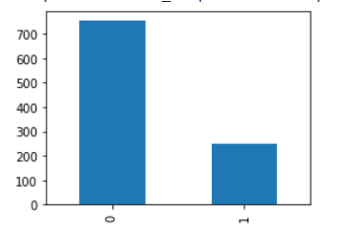
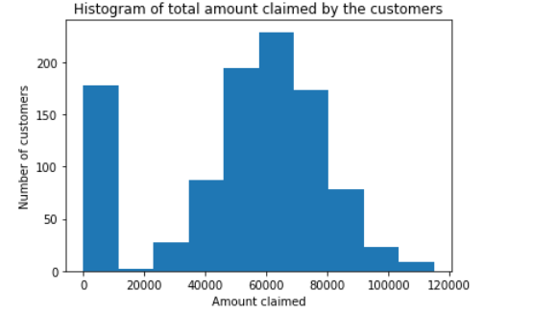
Analysis Questions:
How many number of frauds reported according to dataset?
According to dataset the frauds reported are low i.e count = 247
2) How many number of insurance claimed by entire customers in particular period?
We can see the amount claimed by entire customers using below plot. The highest claimed amount is 70000 and lowest is 110000

Slide 21
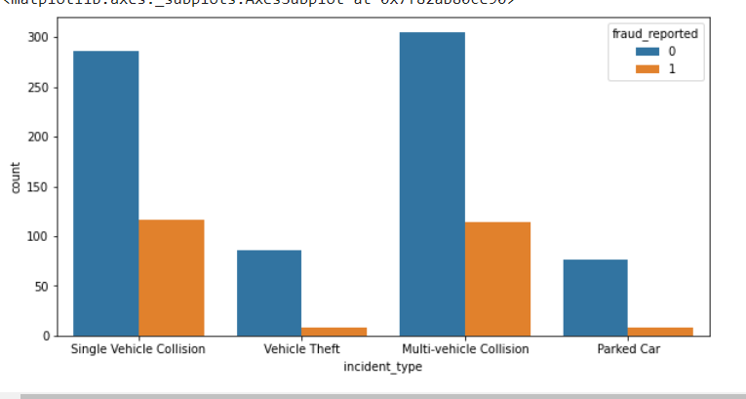
3) How many incident types have highest fraud cases that exceed non fraud cases?
As per the below plot multi vehicle Collison has the highest fraud reported and parked car has the lowest non fraud cases

Slide 22
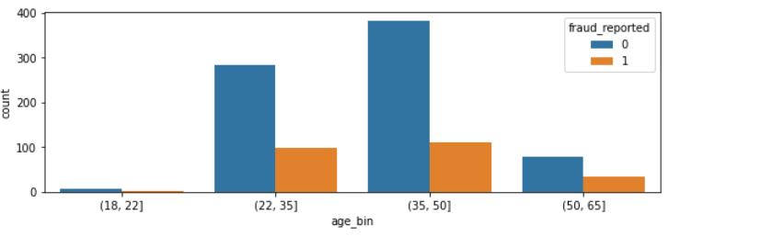
4) Which age group has reported maximum frauds according to dataset?
As per the below plot we can see that maximum number of frauds are claimed by age group
35 to 50

Slide 23
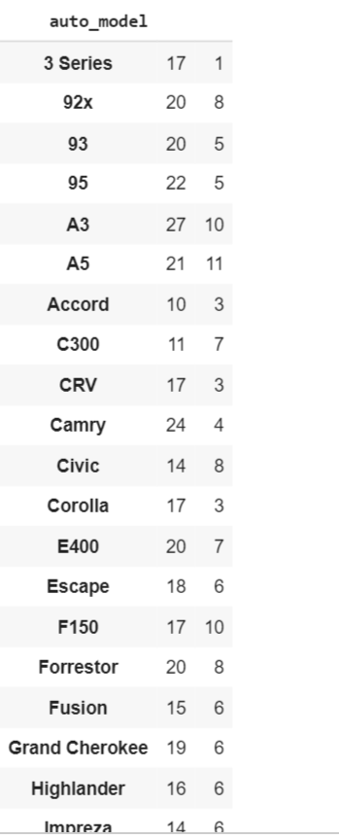
5) Brief description about fraud reported by various auto models?
Below screenshot describes count of frauds reported by different auto models

Slide 24
Key takeaways:
Predictive quality depends more on data than on algorithm
Poor performance from logistic regression and relatively poor performance by odified MVG:
Conclusion:
The machine learning models that are discussed and applied on the datasets were able to identify most of the fraudulent cases with a low false positive rate i.e. with a reasonable precision. This enables loss control units to focus on new fraud scenarios and ensuring that the models are adapting to identify them. Certain datasets had severe challenges around data quality, resulting in relatively poor levels of prediction.
Given inherent characteristics of various datasets, it would be impractical to a' priori define optimal algorithmic techniques or recommended feature engineering for best performance. However, it would be reasonable to suggest that based on the model performance on back-testing and ability to identify new frauds, the set of models offer a reasonable suite to apply in the area of insurance claims fraud. The models would then be tailored for the specific business context and user priorities.

Slide 25
References:
1) 3 Data Science - Insurance Claims – Databricks
2)Risks | Free Full-Text | Predicting Motor Insurance Claims Using Telematics Data—XGBoost versus Logistic Regression | HTML (mdpi.com)
3)Vehicle Insurance Claim Prediction - Synthesized Template
4)Predictive Analytics For Insurance Fraud Detection - Wipro
Recommendations:
We recommend that according to the plot customers who are paying very low premium per month can claim maximum vehicle amount.
Out of all fraudulent claims, 20% of them have involvement with multiple parties and when a multiple party is involved there is a 73% of chance to perform a fraud. So, we recommend not to involve third parties.

